Slide 1

Root Cause Analysis of issues in Rocket Launching System (KAVACH)
    Presented by
    M Sasi Kiran( 16131A03F0)
    M S S Manikanta ( 16131A03E1)
    P Neha Vimal Ratna ( 16131A03G0)
    B.Tech(Mechanical Engineering)
Under the guidance of
Dr. Kiran Kolluru
Associate Professor
Department of Mechanical Engineering
Gayatri Vidya Parishad College of Engineering (Autonomous)
Visakhapatnam-530048

Slide 2
Abstract
Decoys in navy applications are usually the containers of aluminum particles used to mislead the incoming enemy missiles by forming an aluminum cloud.
Proper rocket launching system of decoys is very important in order to protect the vessel.
Kavach rocket system of Indian Navy has occasional malfunctions such as rocket not leaving the launcher and rocket leaving the launcher without tail fins.
In this project, root cause analysis for these malfunctions will be carried out and appropriate solutions will be proposed.
Possible causes such as insufficient thrust, high strength shear pin, thermal mismatch between rocket and launcher tube will be investigated.
Entire rocket launching system will be modeled in CATIA and analyzed in ANSYS to find out the root cause and validate the recommended solutions.

Slide 3
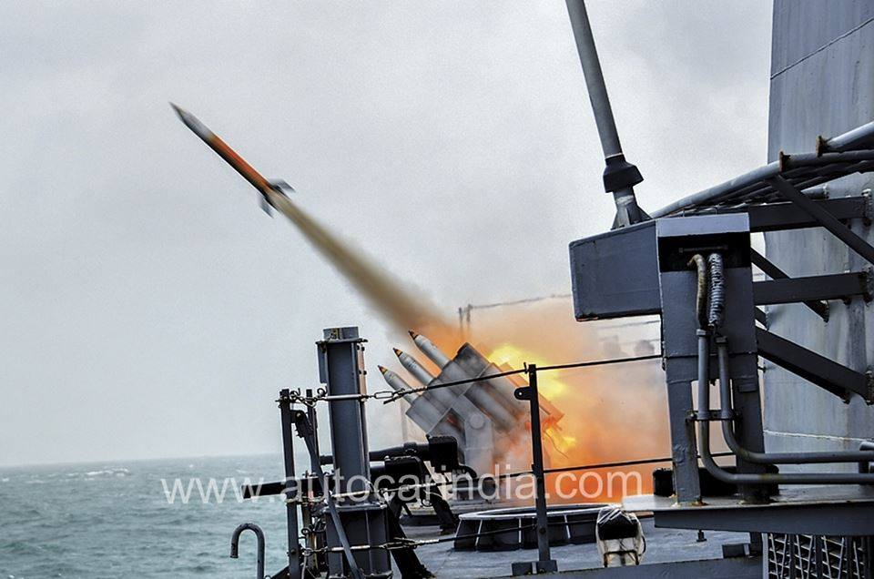
CHAPTER -1
INTRODUCTON
Rocket Body
Fins
Launcher
KAVACH ROCKET SYSTEM
Source[1]
Issue-1: Rocket not leaving the Launcher Tube
Issue-2: Rocket leaving the Launcher Tube without Fins

Slide 4
Chapter-2
REVIEW OF LITERATURE
Geoff Vorley [1] investigated root cause analysis of several cases in manufacturing industries , and suggested the methods and procedures to be followed in his book “Mini Guide to Root Cause Analysis “.
Anoop Thankachen et al.[2] investigated on the design optimization and stress analysis of rocket structure for aerospace application experimentally using ANSYS .
Shaik shahneen et al.[3] investigated on the design and thermal analysis of rocket motor casing using ANSYS and by comparing maximum equivalent stress , deformation and maximum equivalent strain values of carbon-epoxy material with that of steel, suggested that efficient material is carbon-epoxy.
Mathieu Mansuy et al [4], performed a new calculation method for worst case tolerance analysis and synthesis in stack type assemblies. As name suggest new approach is considered for the stack assemblies without clearance and with clearance. It is concluded that there are so many factors that affect the stack-up analysis which assembly having clearance.

Slide 5
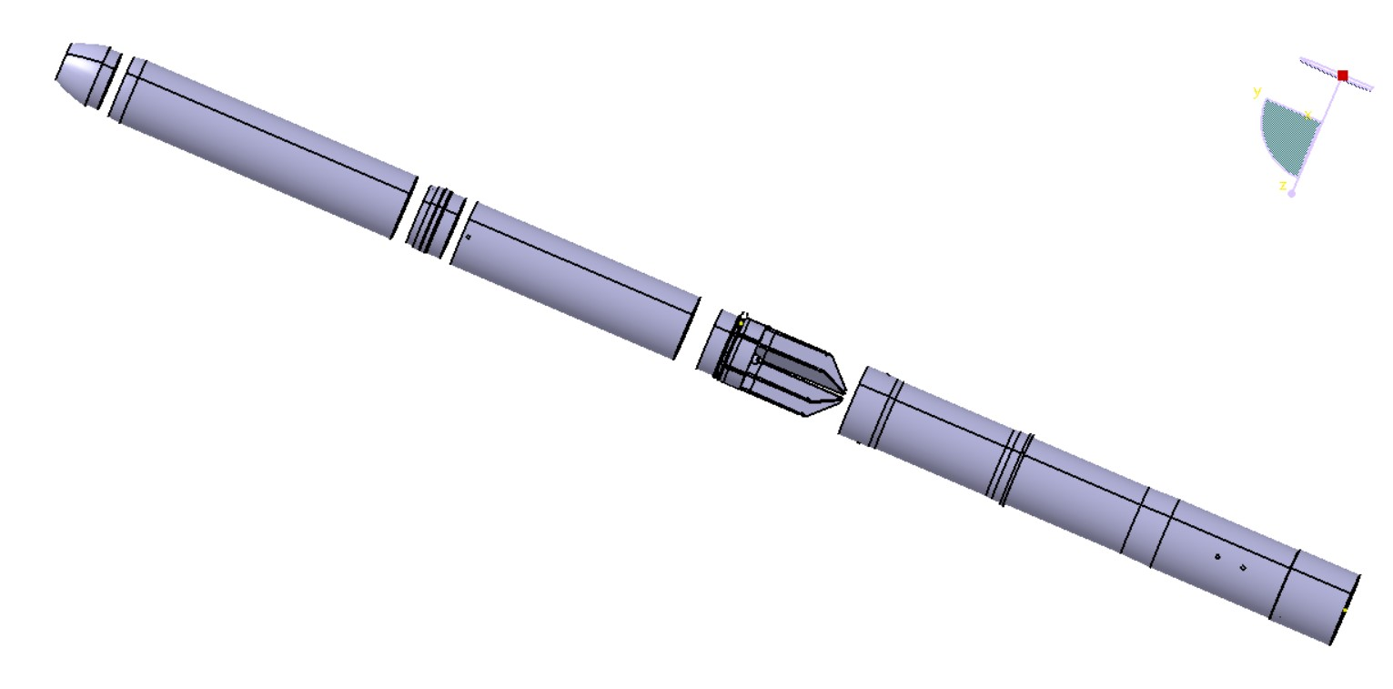
2.1 Rocket - Launcher Assembly
Body
(AA2014)
Motor Tube(AISI4130)
Base Adapter(AISI1040)
Fins(AA2014)
Launcher Tube(AISI316)
Stopper pin (AISI316)
Nozzle Block(AISI1040)
Shear pin (AISI4340)

Slide 6
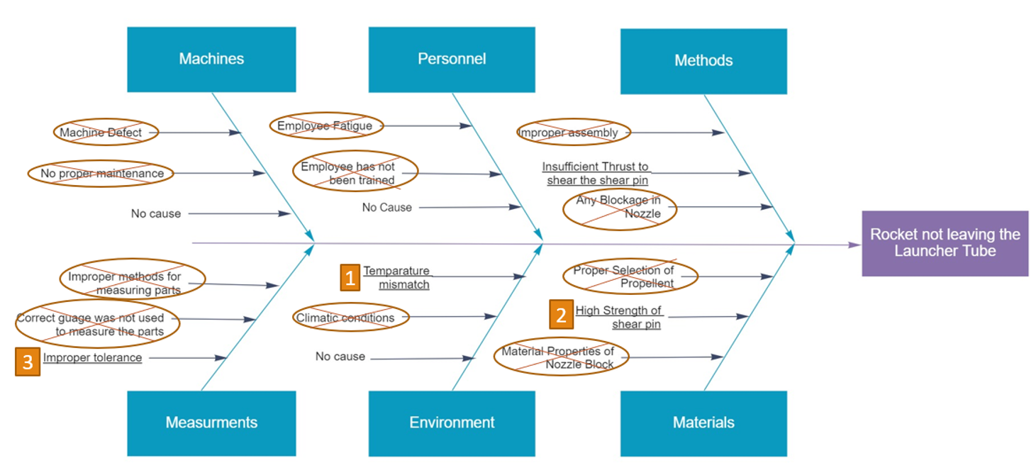
2.2 Fishbone Diagram for Issue-1

Slide 7
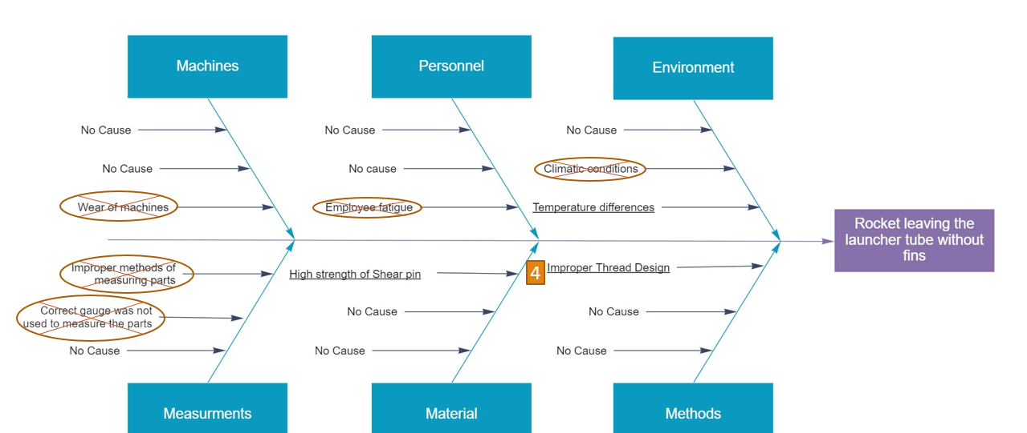
2.3Fishbone Diagram for Issue-2

Slide 8
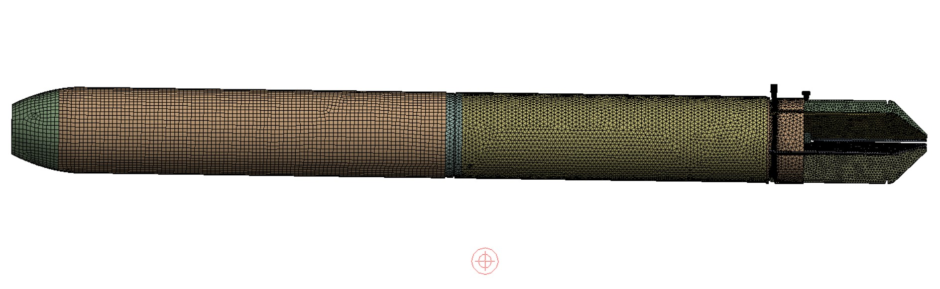

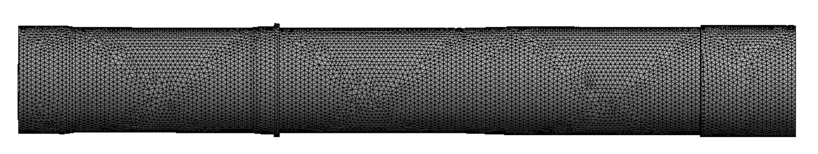

Chapter-3
Finite Element Model Preparation
Finite Element Model of Rocket
Finite Element Model of Launcher Tube

Slide 9
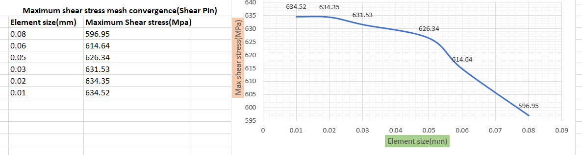
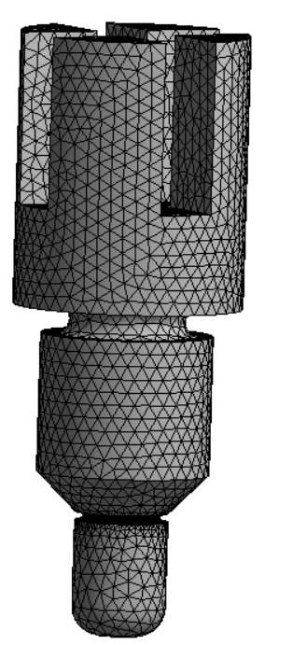
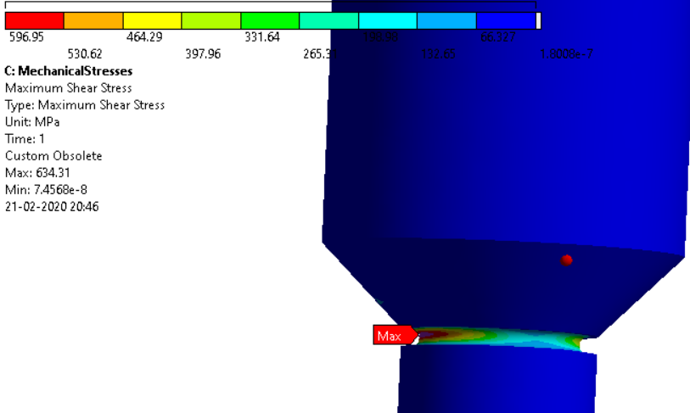
3.1 Mesh convergence study(Shear Pin)
Final Meshed Model

Slide 10
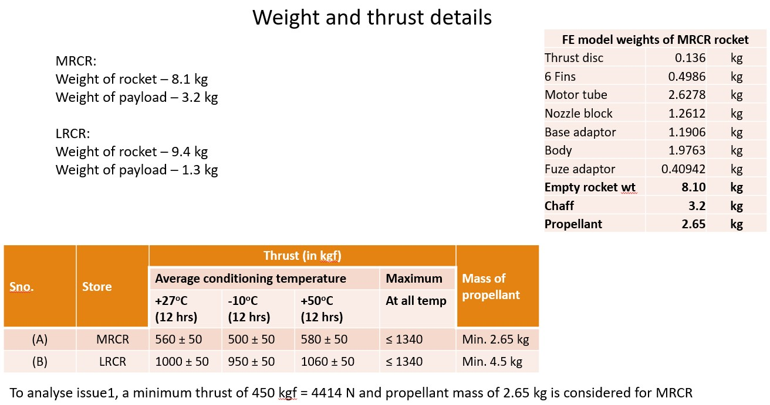
3.2 FE Model Weights Of MRCR Rocket
Component Details | Weight in Kg
Motor Tube | 2.6278
Nozzle Block Assembly | 2.034
Base Adapter | 0.7206
Body | 4.9426
Fuse Adapter | 0.48578
6 Fins | 0.4908
Empty Rocket Weight | 8.1
Chaff | 3.2
Total Rocket Weight | 11.3
Propellant | 2.65
Weight details given by CNAI, Indian Navy

Slide 11
Possible cause – 1: Thermal expansion studies

Slide 12
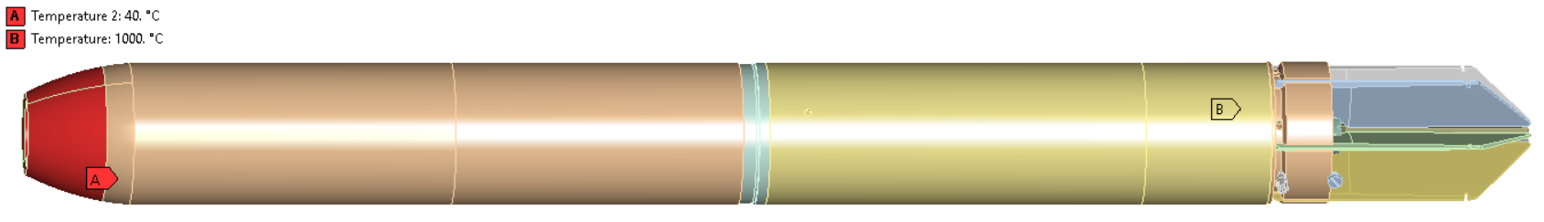
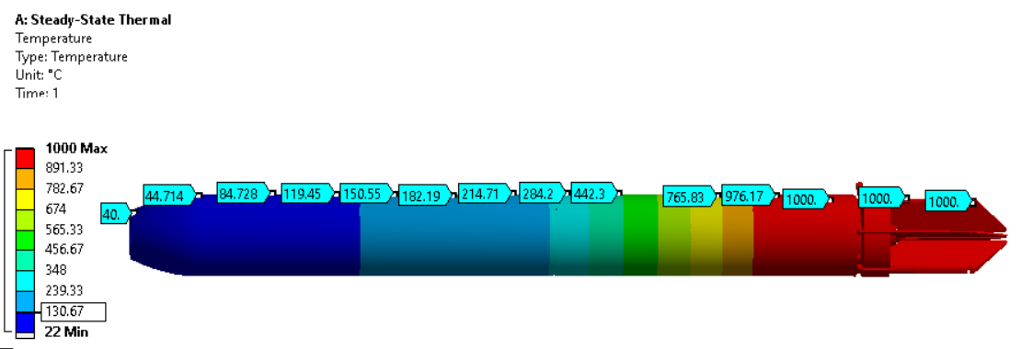
CHAPTER 4
Steady State Thermal Analysis of Rocket
Assumptions:- Temperature at Fuse Adapter =40°C
Temperature of Propellent =1000°C
Temperature Distribution of Rocket

Slide 13
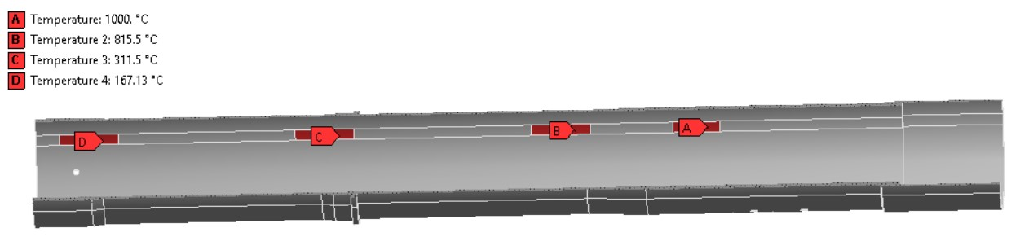
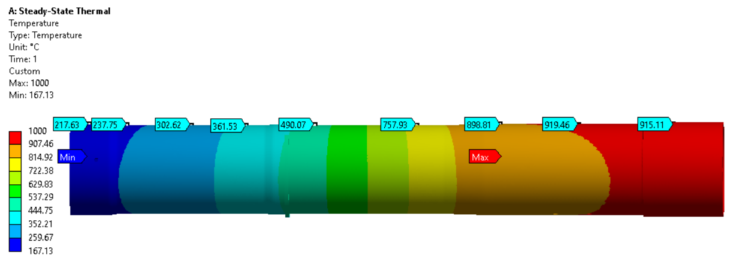
4.1 Steady State Thermal Analysis of Launcher Tube
Temperature Distribution of Launcher Tube

Slide 14
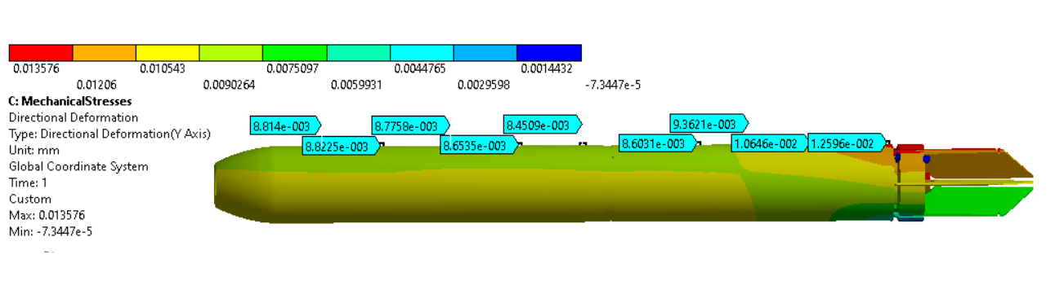
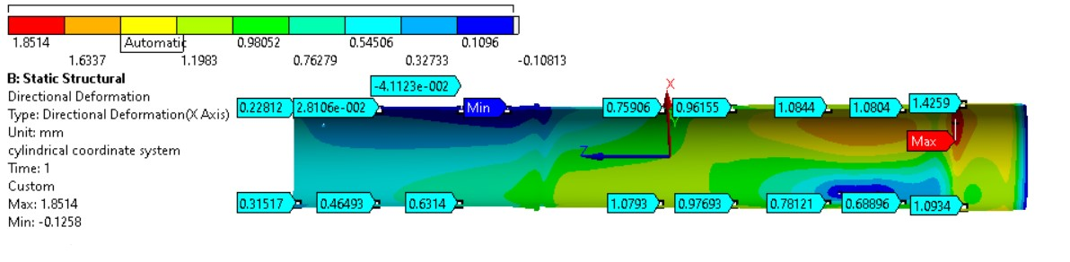
4.2 Directional Deformation of Rocket & Launcher Tube
Initial gap between the Rocket and Launcher Tube is 0.5mm. By analysis, Radial expansion of Launcher Tube is more than that of the Rocket. The minimum gap between the rocket and the launcher tube is 0.98435mm.
Hence, Rocket doesn’t get stuck in the Launcher Tube.

Slide 15
Possible cause – 2: Strength Analysis of Shear pin

Slide 16
4.3 Thrust Details of MRCR
(provided by CNAI, Indian Navy)
To Analyze issue-1 ,a minimum Thrust of 450kgf and propellant mass of 2.65kg is considered for MRCR
450Kgf=450×9.81=4414N

Slide 17
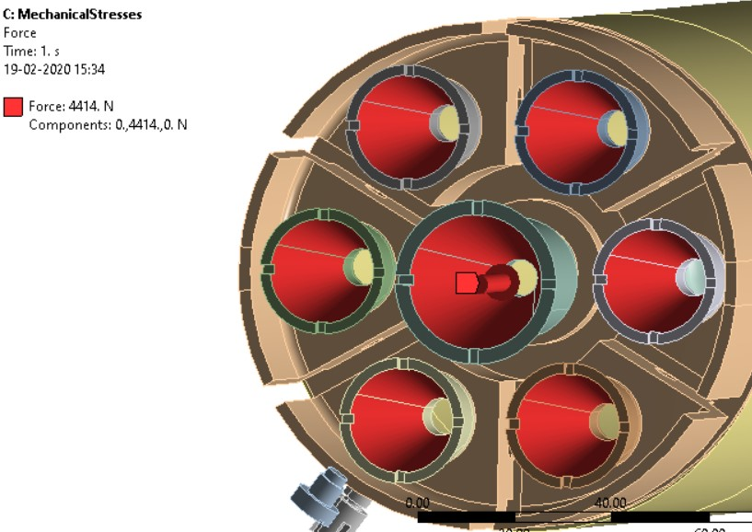
4.4 Thrust Application in FE Model

Slide 18
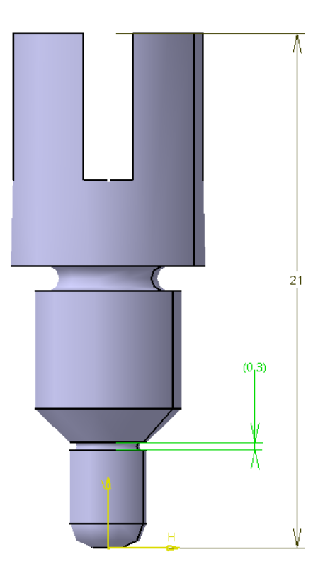
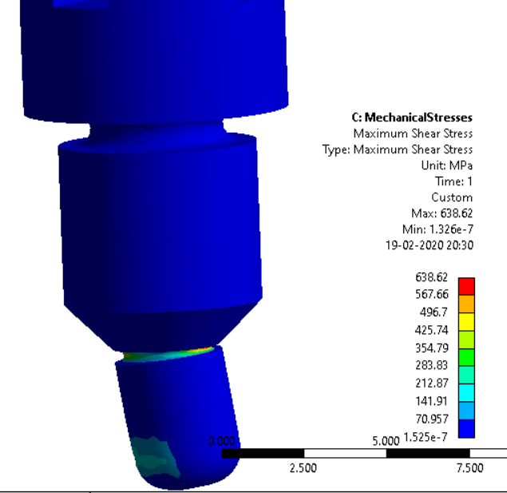
4.5 Maximum Shear Stress at Shear Pin
(Neck diameter)
Maximum shear stress observed in the neck region of the shear pin (638.62 MPa) is higher than the shear strength of the EN24 material (393 MPa)

Slide 19
Possible cause 3 :Stopper pin locating in fin groove

Slide 20
CHAPTER-5
TOLERANCE STACKUP ANALYSIS for issue 1
What is Tolerance Stack up Analysis
Process of determining the cumulative variation of Dimensions between two or more mechanical parts.
Determines the maximum possible variation between two components in an Assembly.

Slide 21
5.1 Uses of Tolerance Stack up Analysis
Optimizes the tolerance of parts and assemblies in a new Design
Balance accuracy, precision and cost with manufacturing Process
Determines the part tolerance required to satisfy final assembly condition
Determines the effect of changing a tolerance will have on the assembly component

Slide 22
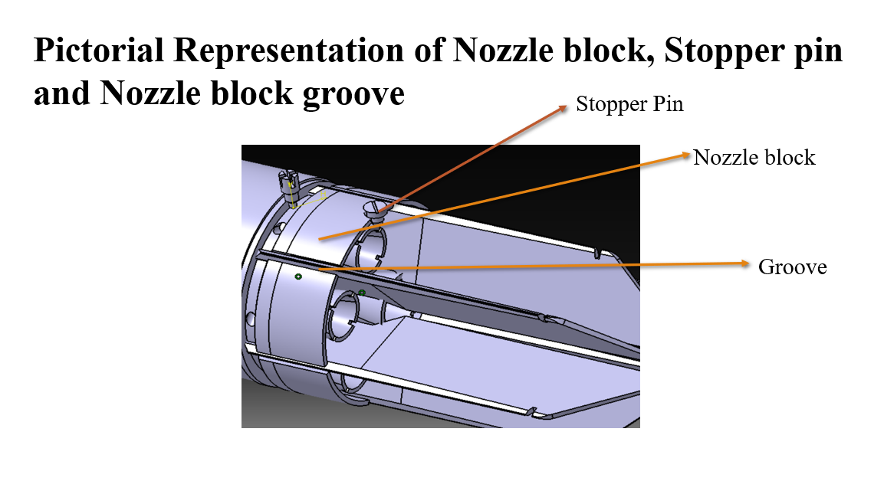
Usually, the end of nozzle block has to rest on the stopper pin which is inserted in the launcher tube

Slide 23
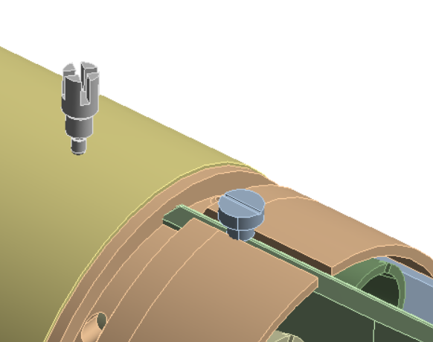
5.2 Assumption For Issue 1
But in practice , due to heavy loading of missiles into the inclined launcher there may be a chance of stopper pin to get settle in the gap between nozzle block fin groove

Slide 24
5.3 Does stopper pin sits in the gap ?
Diameter of the stopper pin tip(D) is 4.7mm
Width of the groove of nozzle block(W) is 5mm
Here D<W so there is possibility that, stopper pin can sit in the nozzle block fin groove if it can deform the triangular web of the fin

Slide 25
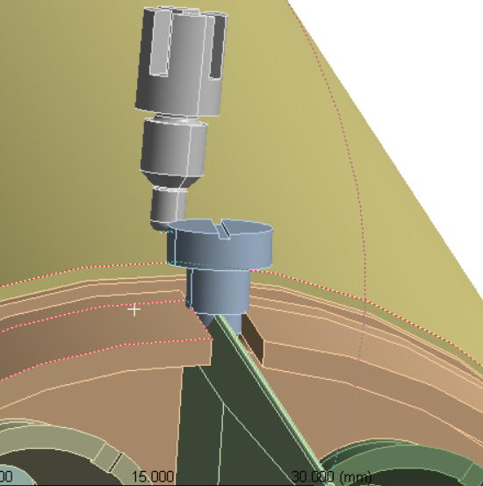
5.4 Calculations
GAPS | DIMENSIONS(mm)
Gap between tip of the fin and nozzle block | 0.35
Gap between extreme end of central nozzle and extreme interior end of fin(the max distance fin can bend) | 0.97
Length of the stopper pin tip on which rocket rests= 2mm
Considering the open tolerance according to the standards IS2012 ,
Open tolerance for 2 mm is ±0.1 mm
New Length of the stopper pin tip (considering tolerance) = 2 +0.1
=2.1 mm

Slide 26
Calculations
The length of the tip that penetrates into the fin
=(total length of the tip )–( gap between tip of fin and nozzle block )-( distance the fin can bends)
= 2.1- 0.35-0.97
=0.77 mm
The thickness of the fin at the depth of 0.77 mm from the tip taking the angle of the fin @30° = tan(15)x0.77x2
=0.41 mm
Considering the open tolerance according to standards IS 2012 , the tolerance for 30° is ±30’
The thickness of the fin at depth of 0.77 mm from the tip taking the angle of the fin @ 30° 30’
= tan(15.25)x0.77x2
= 0.42 mm

Slide 27
Table showing the thickness of the fin at a depth 0f 0.77 mm from its tip
Angle of the fin | Thickness in (mm)
30° | 0.41
30° 30’ | 0.42
As 0.42 mm is very small and material of the fin is aluminum , stopper pin can easily deform the triangular web of the fin and settle in gap between the fin and nozzle block fin groove.
Then the shear pin gets located on the motor tube and there may be a possibility that shear pin may not get sheared ,which in turn leads to rocket not leaving the launcher tube

Slide 28
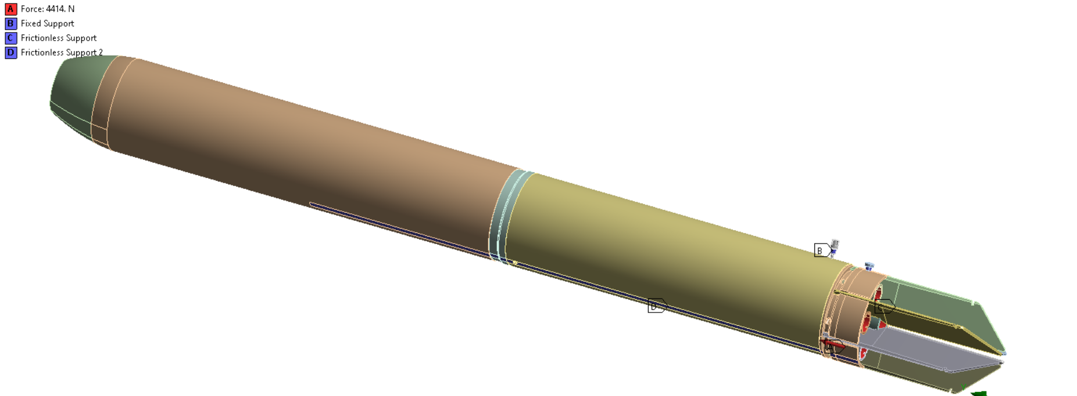
5.5 Static structural analysis considering tolerance stack up
Boundary conditions

Slide 29
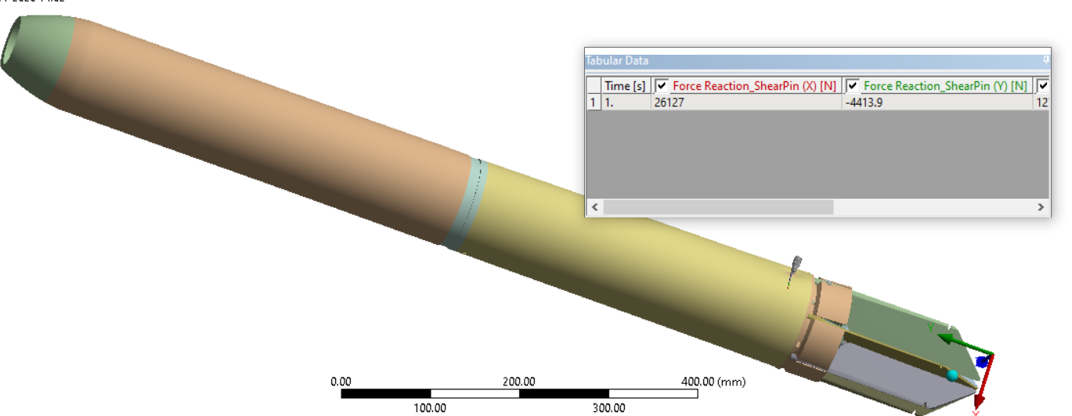
5.6 Force Reaction exerted by shear pin
As we clearly see that reaction force at shear pin is 4413.9N which is equals 4414N in general. So thrust force is capable to shear the shear pin.
Therefore, the rocket leaves the launcher tube.

Slide 30
5.7 Recommendations for issue 1
The diameter of the stopper pin should be more than 5.3mm i.e., more than the width of the nozzle groove and considering the worst case tolerance on nozzle block gap and stopper pin , this would still prevent the stopper pin from getting into the groove.
The length of the stopper pin tip ,where the nozzle block rests should be increased to a certain limit so that it does not collide with the peripheral nozzles

Slide 31
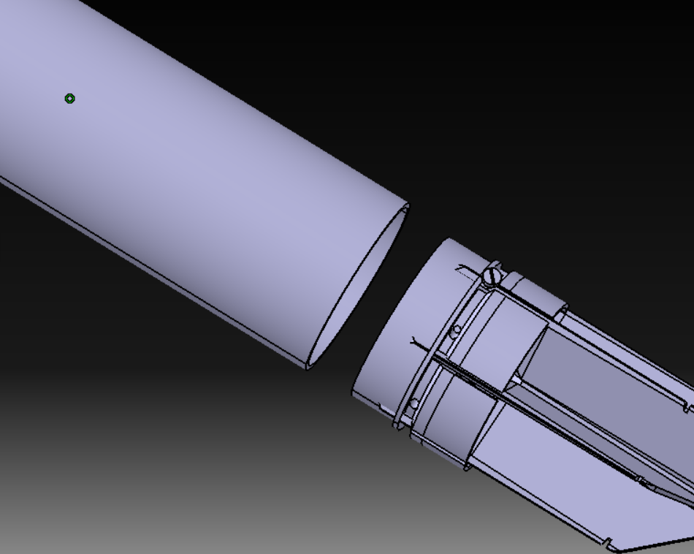
CHAPTER-6
ISSUE 2- Rocket Leaving The Launcher Tube Without Fins
The fins are attached to the nozzle block ,in the fin groove by means of spring support.
The nozzle block with fins is fitted to the motor tube of rocket by a threaded joint.
Motor tube
Nozzle block
If the threaded joint does not have sufficient thread contact length ,there may be a chance of unthreading of the joint, thereby rocket leaves the launcher tube without fins.

Slide 32
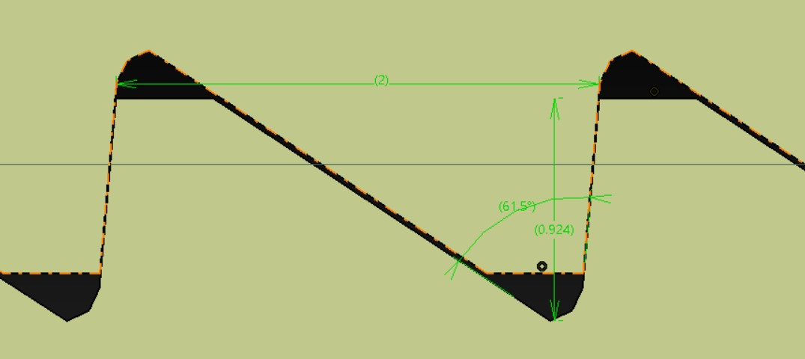
6.1 Thread Joint Analysis
The Buttress thread joint ,shown in the figure is designed according the dimensions given by CNAI
(0.825)
contents | dimension
pitch | 2 mm
overlap | 0.825 mm

Slide 33
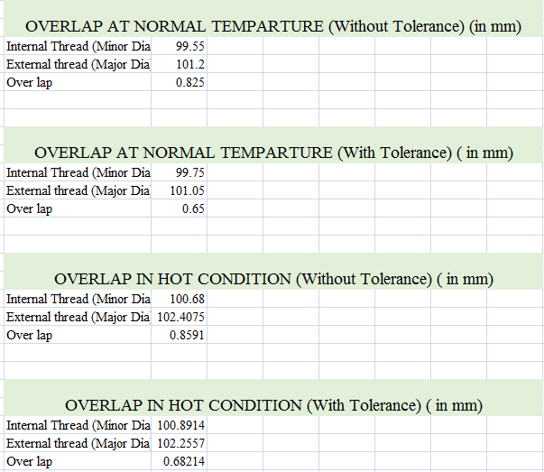
6.2 Calculations of overlap of the Threaded joint

Slide 34
6.3 Observations
From the above calculations we observed that , the threaded joint have the more root strength of the thread.
At the same time , the overlap of the threaded joint 0.825 mm is much less than that of the overlap of standard buttress thread recommendation of 0.75P i.e. 0.75 times 2=1.5 mm according to standards IS.4696.
Therefore ,insufficient thread contact length may be the reason for rocket leaving the launcher tube without fins.
So, We have modified the thread design by increasing its thread contact area without compromising in its root strength

Slide 35
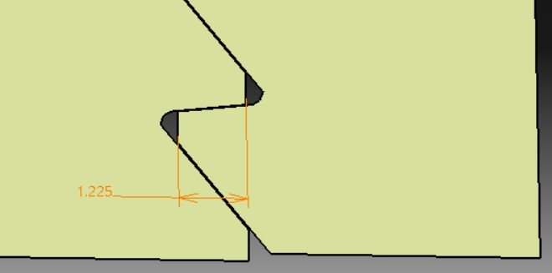
6.4 New Modified Threaded Joint Dimensions
CONTENTS | DIMENSION
Pitch | 2 mm
Overlap | 1.225 mm
We have increased the overlap by 0.4 mm .
New overlap=original overlap+0.4= 0.825+0.4 =1.222 mm.

Slide 36
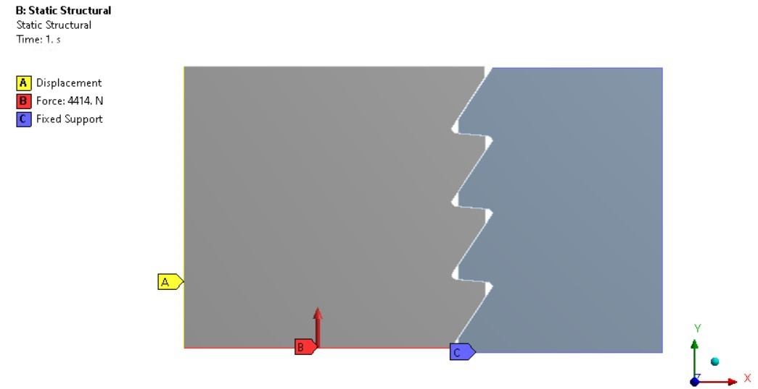
6.5 Static Structural Analysis of threaded joint
Force Application on FE model
Original threaded joint
New modified Threaded joint
Nozzle block
thread
Nozzle block
thread
Motor tube thread
Motor tube thread

Slide 37
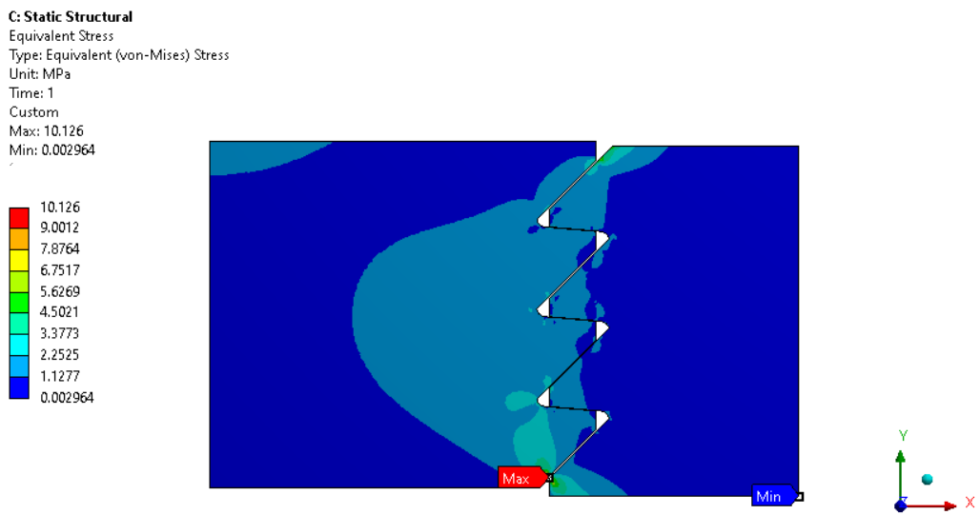
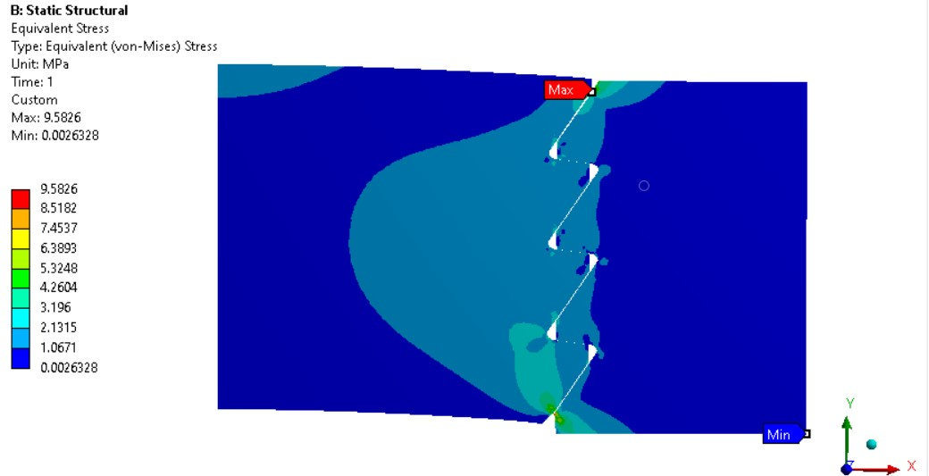
6.6 Equivalent Stress
Original Threaded joint
New Modified threaded joint
Maximum equivalent stress of new threaded joint is more than that of the original threaded joint.
Though the stress is increased, it is only very minor=10.12-9.58=0.54MPa.This slight increase has no major impact as the yield strength of the material is very high.
Yield strength of Nozzle block(AISI 1040) = 415MPa.
Yield strength of Motor Tube(AISI 316) = 205MPa.

Slide 38
6.7 Recommendations for issue -2
The overlap of the threaded joint should be increased in order to increase the strength of the threaded joint.
Similarly the major and minor diameters of nozzle block and motor tube are also changed as in table.
components | For Original threaded joint |  | For New Modified threaded joint
 | Major diameter (mm) | Minor diameter (mm) | Major diameter (mm) | Minor diameter (mm)
Nozzle block | 101.2 | 99.3 | 101.6 | 98.9
Motor Tube | 101.4 | 99.55 | 101.8 | 99.15

Slide 39
Conclusion
The diameter of the stopper pin should be more than 5.3mm i.e., more than the width of the nozzle groove and considering the worst case tolerance on nozzle block gap and stopper pin , this would still prevent the stopper pin from getting into the groove.
The length of the stopper pin tip ,where the nozzle block rests should be increased to a certain limit so that it does not collide with the peripheral nozzles
The overlap of the threaded joint should be increased in order to increase the strength of the threaded joint.
Similarly the major and minor diameters of nozzle block and motor tube are also to changed

Slide 40
References
[1]Source: https://www.facebook.com/IndianDefenceFacts/
[2]Geoff Vorley, ”Mini Guide to Root cause analysis”, published by Quality Management & Training(Publications)
ltd 2008.
[3] Anoop Thankachen, Santosh Kumar, ”Design Optimization and Analysis of Rocket structure for Aerospace application”, international journal of engineering trends & technology(IJETT), volume 24, number 6, June2015.
[4] Shaik Shaheen, Dr.G.Srinivasa Gupta, ”Design and Analysis of Carbon –Epoxy Composite Rocket Motor Casing”, VNR Vignana Jyothi Institute of Engineering and Technology,2015.
[5] Mathieu Mansuy, Max Giordano, Pascal Hernandez: “A new calculation method for the worst case tolerance analysis and synthesis in stack-type assemblies”, International Journal of Science, M. Mansuy et al. / Computer-Aided Design 43 (2011)
[6]Cheng S Chin, “Design and Analysis of Composite Rocket Motor Casing”, William Atmodihardjo, Lok W Wool and Ehsan Mesbahi Chin et al. Robomech Journal(2014)2:4.
[7] Sheikh Naunehal Ahamed, Jadav Vijay Kumar, Mohammed Mushraffuddin, Parimi Shrawini, “Modeling and Analysis of Rocket Outer Shell”, international journal of scientific & technology research volume 3, issue 4, April 2014.

Slide 41
Thank You

